Slide 1
Team 19 – geeks4hire
Sai Prashanth Chandramouli (schand31@asu.edu) Shravan Purohit (shravan.purohit@asu.edu) Dilip Selamanthu (dselaman@asu.edu) Swetha Baskaran (sbaskar3@asu.edu)

Slide 2
Support My Club - SMC
What do we have?
An excellent front-end, with a robust e-commerce solution built with Shopify.
A form based submission system for “Thank You” emails.
A mailer system in place, that allows these emails to be forwarded to the right people.

Slide 3
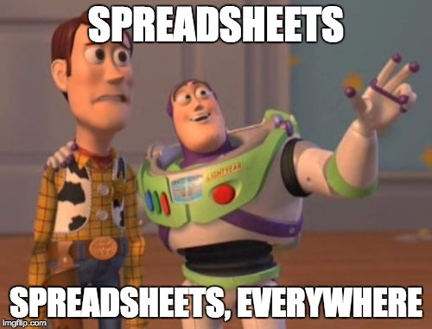
Well, what is wrong with the current system?

Slide 4
The Elephant in the room – Data Management
E-Mails are generic, no way to encourage people to donate to causes they care about.
E-Mails need to be sent manually ☹
Data is not in a consistent format, and is all over the place.
Shopify has the Order data, Wufoo has the “Thank you” form data.
Facebook Integration is not put to its fullest use.
Conventional mechanisms to contact new donors.

